Slide 1



A Civil War Story

Slide 2
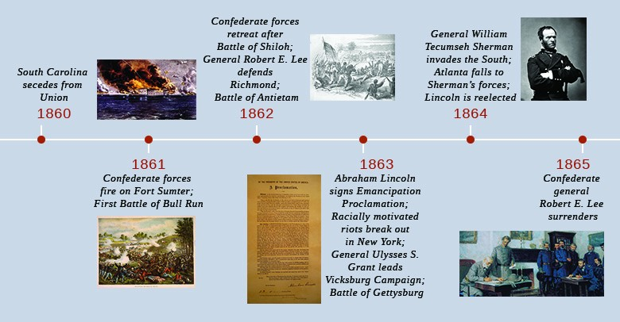
The Toll of War
1864 - 1865 -1866

Slide 3
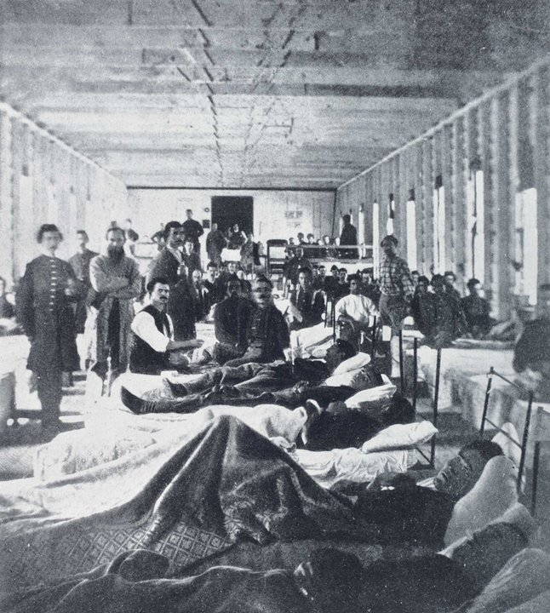
Disease is a Factor
Over 2/3 of Civil War deaths were from disease
Top 4 Diseases:
Cholera - Typhus – Pneumonia – Consumption (TB)

Slide 4
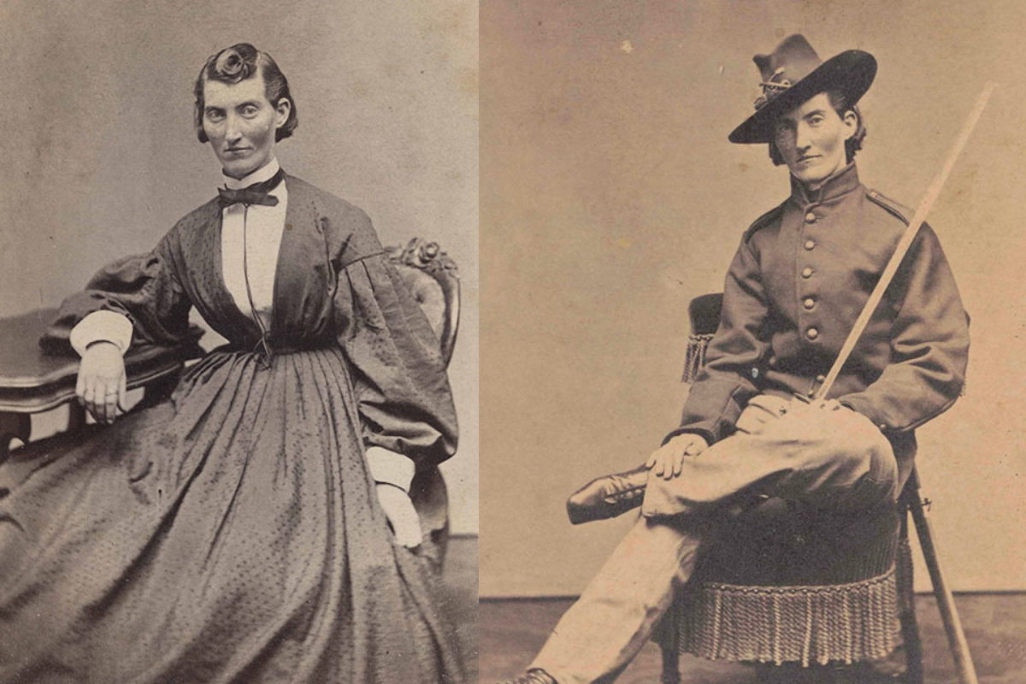
Female Deaths Were Just As High?
Females were heavily involved in the Civil War
Dressed and fought as males
Disease
Overworked (Assisting Supply Lines, Tending to Farmland, Malnutrition)

